Slide 1


TOPIC: Introduction to Internet and WWW
COURSE: CCC Concept
CHAPTER: Introduction to Internet and WWW
DAY: 33
Presentation By: Shruti Dubey

Slide 2
Content
What is Network
Wide area Network
Local area Network
Wide area Network
Metropolitan area Network
Campus area Network
Personal area Network
Type of Network
Network Topologies
Bus Topology
Ring Topology
Star Topology
Mesh Topology
Modes of connected Internet
Difference between MAC address and IP address
What is web browsers
Popular web browsers
Useful Links

Slide 3
What is Network?
A network, in computing, is a group of two or more devices that can communicate. In practice, a network is comprised of a number of different computer systems connected by physical and/or wireless connections.
Needs of Networking
File sharing – you can easily share data between different users, or access it remotely if you keep it on other connected devices.

Slide 4
What is Network?
Resource sharing – using network-connected peripheral devices like printers, scanners and copiers, or sharing software between multiple users, saves money.
Sharing a single internet connection – it is cost- efficient and can help protect your systems if you properly secure the network.
Increasing storage capacity – you can access files and multimedia, such as images and music, which you store remotely on other machines or network- attached storage devices.

Slide 5

What is Network?
Resource sharing – using network-connected peripheral devices like printers, scanners and copiers, or sharing software between multiple users, saves money.
Types of Network
Local Area Network (LAN)
Wide Area Network (WAN)
Metropolitan Area Network(MAN) cable TV networks
Value Added Network (VAN)
Campus Area Network(CAN)
Home Area Network(HAN)
Portable Area Network(PAN)

Slide 6
What is Network?
Resource sharing – using network-connected peripheral devices like printers, scanners and copiers, or sharing software between multiple users, saves money.
Types of Network
Local Area Network (LAN)
Wide Area Network (WAN)
Metropolitan Area Network(MAN) cable TV networks
Value Added Network (VAN)
Campus Area Network(CAN)
Home Area Network(HAN)
Portable Area Network(PAN)

Slide 7
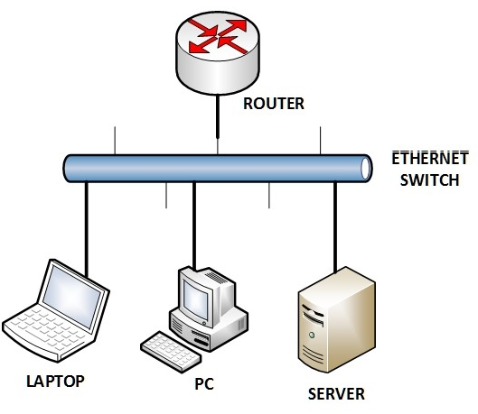
Local Area Network (LAN)

Slide 8
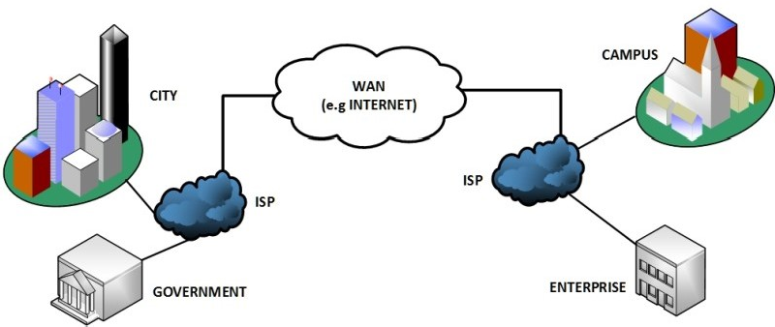
Wide Area Network (WAN)

Slide 9
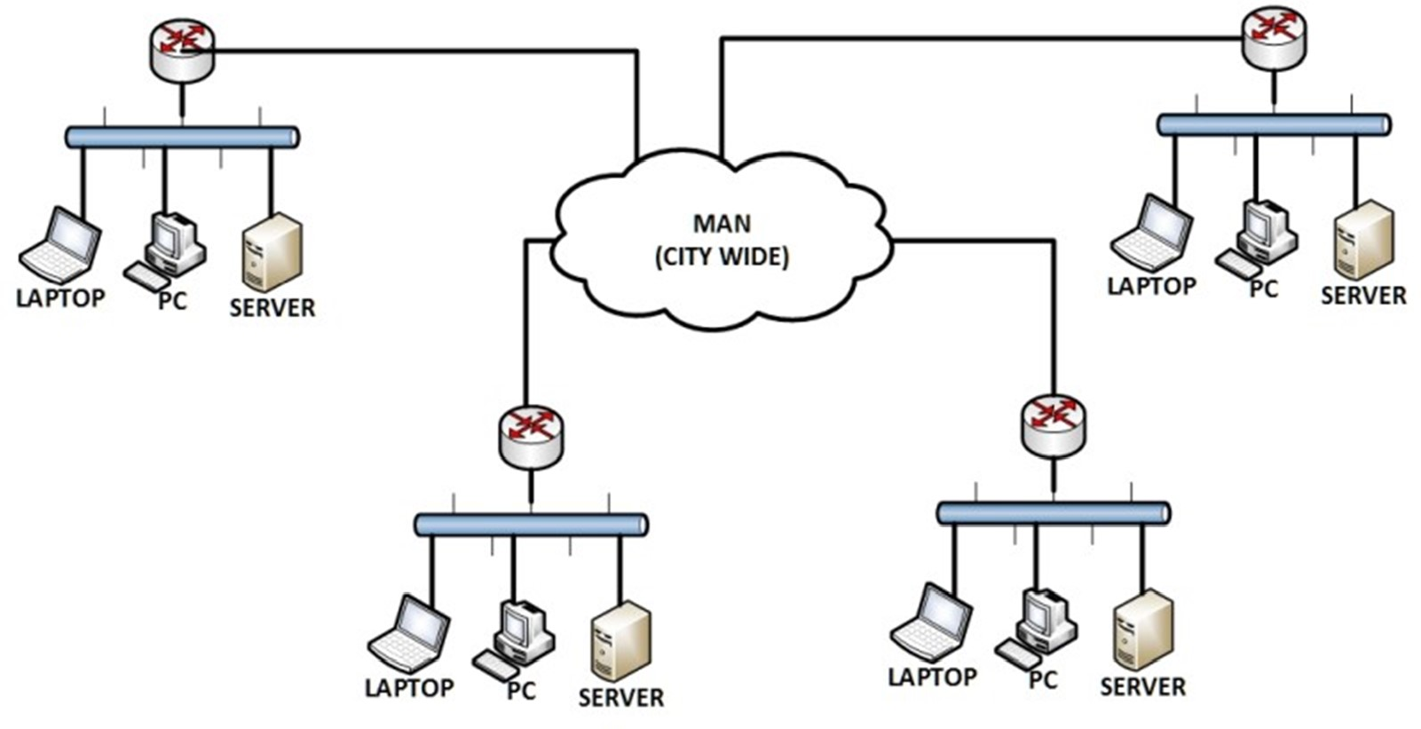
Metropolitan Area Network (MAN)

Slide 10
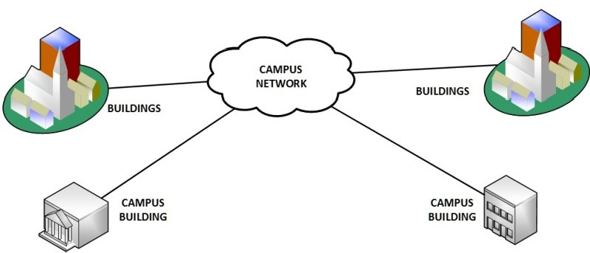
Campus Area Network (CAN)

Slide 11
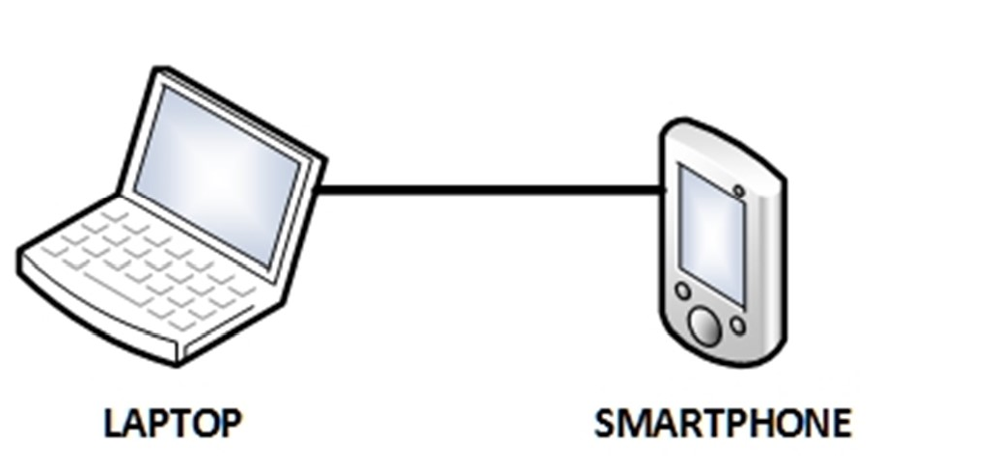
Personal Area Network (PAN)

Slide 12
Types of Network
Client/Server Method of Connecting Computers
Client
A client is a program that runs on the local machine requesting service from the server. A client program is a finite program means that the service started by the user and terminates when the service is completed.
Server
A server is a program that runs on the remote machine providing services to the clients. When the client requests for a service, then the server opens the door for the incoming requests, but it never initiates the service.

Slide 13
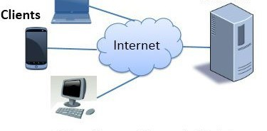
Types of Network
Client/Server Method Computers
of Connecting

Slide 14
Types of Network
Characteristic's of client
Activities Master Computer
Initiates requests
Wait for and receives replies
Connect to one or more numbers of servers at one time
Typically interacts directly with end-users using a Graphical User Interface(GUI).
Characteristic's of server
It waits for requests from clients.
Upon receipt of requests, it processes them and then offer replies.
It usually accepts connections from a larger number of clients.
It is not interact directly with end-users.

Slide 15
Network Topologies
Topology defines the structure of the network of how all the components are interconnected
to each other.
Topologies
Bus Topology
Ring Topology
Star Topology
Mesh Topology

Slide 16
Bus Topology
The bus topology is designed in such a way that all the stations are connected through a single cable known as a backbone cable.
Each node is either connected to the backbone cable by drop cable or directly connected to the backbone cable.
When a node wants to send a message over the network, it puts a message over the network. All the stations available in the network will receive the message whether it has been addressed or not.

Slide 17
Bus Topology
Advantages of Bus Topology
Low cost cable.
Coaxial or twisted pair cables are mainly used in bus-based networks that support unto 10 Mbps.
A failure in one node will not have any effect on other nodes.

Slide 18
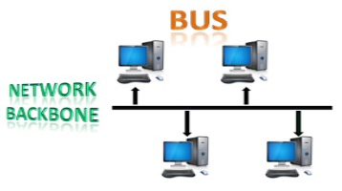
Bus Topology

Slide 19
Ring Topology
The node that receives the message from the previous computer will retransmit to the next node.
The data flows in one direction, i.e., it is unidirectional.
t has no terminated ends, i.e., each node is connected to other node and having no termination point.
The data in a ring topology flow in a clockwise direction.

Slide 20
Ring Topology
The node that receives the message from the previous computer will retransmit to the next node.
Advantages of Ring Topology
Faulty devices can be removed from the network without bringing the network down.
Twisted pair cabling is inexpensive and easily available. Therefore, the installation cost is very low.
It is a more reliable network because the communication system is not dependent on the single host computer.

Slide 21
Ring Topology
Disadvantages of Ring Topology
Faulty devices can be removed from the network without bringing the network down.
Twisted pair cabling is inexpensive and easily available. Therefore, the installation cost is very low.
It is a more reliable network because the communication system is not dependent on the single host computer.

Slide 22
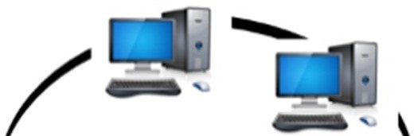
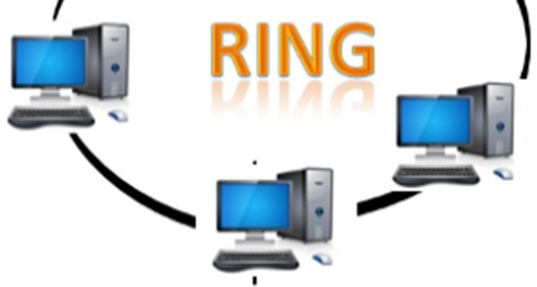
Ring Topology

Slide 23
Star Topology
Star topology is an arrangement of the network in which every node is connected to the central hub, switch or a central computer.
The central computer is known as a server, and the peripheral devices attached to the server are known as clients.
Coaxial cable or RJ-45 cables are used to connect the computers.
Hubs or Switches are mainly used as connection devices in a physical star topology.
Star topology is the most popular topology in network implementation.

Slide 24
Star Topology
Advantages of Star Topology
In a star topology, all the stations are connected to the centralized network. Therefore, the network administrator has to go to the single station to troubleshoot the problem.
It is easily expandable as new stations can be added to the open ports on the hub.
It supports a bandwidth of approx. 100Mbps.

Slide 25
Star Topology
Disadvantages of Star Topology
The central hub or switch goes down, then all the connected nodes will not be able to communicate with each other.
Required more cable length.

Slide 26
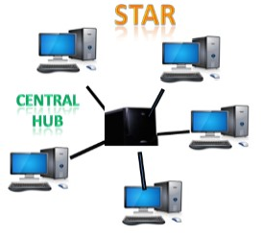
Star Topology

Slide 27
Mesh Topology
Mesh technology is an arrangement of the network in which computers are interconnected with each other through various redundant connections.
There are multiple paths from one computer to another computer.
It does not contain the switch, hub or any central computer which acts as a central point of communication.
The Internet is an example of the mesh topology.
Mesh topology is mainly used for wireless networks.

Slide 28
Mesh Topology
Mesh technology is an arrangement of the network in which computers are interconnected with each other through various redundant connections.
Advantages of Mesh Topology
The mesh topology networks are very reliable as if any link breakdown will not affect the communication between connected computers.
Communication is very fast between the nodes.
Adding new devices would not disrupt the communication between other devices.

Slide 29
Mesh Topology
Disadvantages of Mesh Topology
Mesh topology networks are very large and very difficult to maintain and manage. If the network is not monitored carefully, then the communication link failure goes undetected.
In this topology, redundant connections are high that reduces the efficiency of the network..

Slide 30
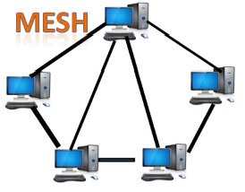
Mesh Topology

Slide 31
Thank you!
www.nielit.gov.in/haridwar

